Slide 1
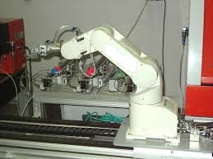
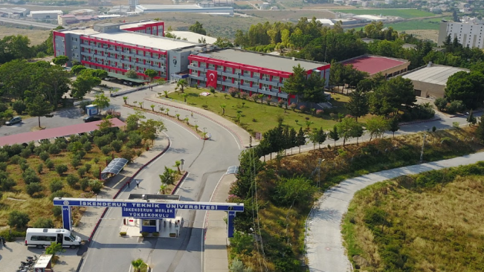
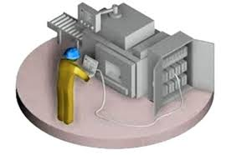
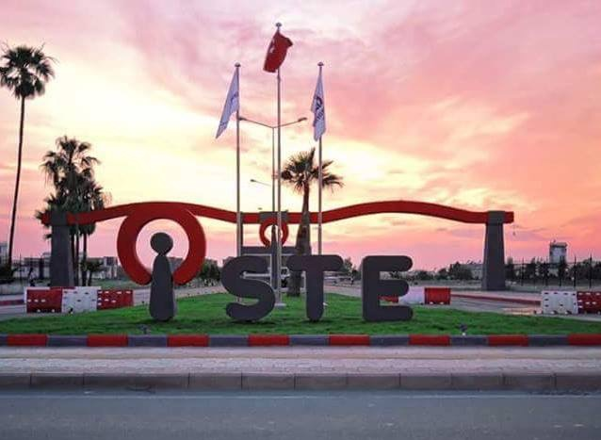
Integration with Business World (IDE)
The program of Integration with Business World is commenced to let graduates of the Technologyof Controlling and Automation program in Iskenderun Vocational School of Higher Education become qualified personnels in the world of work. Businessmen showed deep interest to the IDE program in a short while.
İSKENDERUN VOCATIONAL SCHOOL
Laboratory Facilities
Microwave Laboratory,
Microcontrollers Laboratory,
CAD (Computer Aided Design) Laboratory,
Electrical Machines Laboratory,
Analog Electronics Laboratory,
Measurement Laboratory,
PLC and SCADA Laboratory,
Process Control laboratory,
Digital Electronic & Design Laboratory,
Transformer Winding Workshop.
İskenderun Technical University İskenderun Vocational School Hill Campus 31200 İskenderun, HATAY
Tel: +90 326 613 56 00
Fax: +90 326 618 29 30
www.iste.edu.tr/imyo-kvot
CONTROL AND AUTOMATION TECHNOLOGY PROGRAM
CONTROL AND AUTOMATION TECHNICIAN WHO?
The Control and Automation Technician is directly responsible for the operation in the premises or the production line in the factory department or in the case of the engineer responsible for the production, or where the legislation permits. In the electronics and automation sector, they can open work places related to companies producing goods / services
Educational Program
Iskenderun Technical University Iskenderun Vocational School Control and Automation Technology Program provides training at the level of Associate Degree. The Associate Degree curriculum has been renewed in accordance with the requirements of the day. The curriculum was tailored to the bologna process and the recommendations of the authorized personnel working in the factories were taken into account.

Slide 2
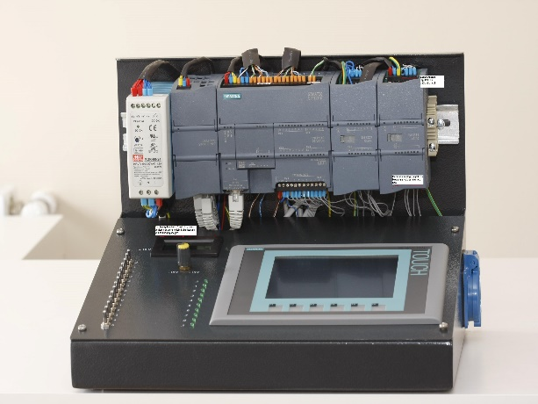
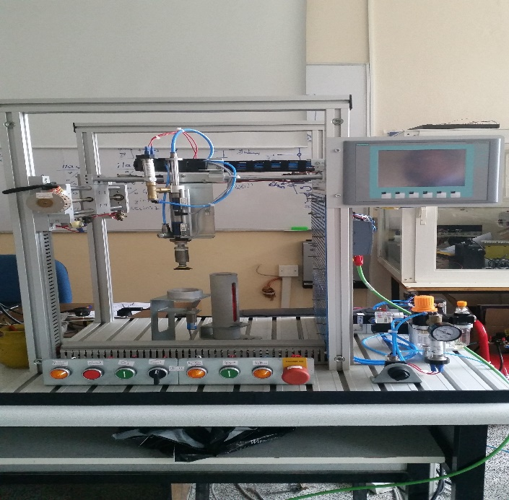
What can Sectors of Control and Automation Technician Work?
DGS (Vertical Transfer Examination) and (4 License to the Annual Faculty) What are the sections that can be settled?
Electrical Engineering,
Teaching of Computer and Controlling
Teaching of Electrical,
Electrical and Electronics Engineering,
Electronics Engineering,
Teaching of Electronics,
Teaching of Electronics and Computer,
Electronics and Communication Engineering,
Teaching of Electronics and Communication,
Manufacturing Engineering,
Control Engineering,
Mechanical Engineering,
Mechatronic Engineering,
Teaching of Mechatronic,
Meteorological Engineering,
Aircraft Elk-Electronics Manufacturing Eng,
Control and Automation Technology students who graduate from the program;
It makes the installation and maintenance of hydraulic and pneumatic systems.
It makes the choice of materials needed to perform the installation of the basic mechanisms and perform the installation.
3D models makes computer-aided drafting.
The design of electrical control circuit, performs installation and maintenance.
Automatic control, establishes operating system related to industrial design and manufacturing.
Computer used in industry prepares the operation programs of numerically controlled machine tools and automatic.
Using a computer and the computer program makes the computer systems of control devices and controls.
Electrical and electronic circuits and this makes the installation of the required measurement process on these circuits.
It makes microcontroller programming.
The automation system performs design.
These characteristics as iron and steel, beverages, cement, filter, power generation and control work in all areas of automation etc. are used.
Why choose the Control and Automation Technology Program?
Strong, experienced and highly qualified academic staff.,
Plenty of opportunity to get hands-on training.
Having a degree program in the field of project competitions,
Hill campus transportation facilities,
Close cooperation with the industry.
Integration with the business world (IDE) allows solving the problem of compliance in the industry.
Ability to make many different parts of the vertical transition after graduation.
Rooted past, bright future.
Social, cultural and club activities.
After graduation job placement and easy to be sought after element,
Indoor sports hall, canteen, cafeteria and dining hall to be.

